Slide 1
Our Goals This Semester
As happens with all of our activities, we are going to be working on at least three different levels this semester:
Level 1: How to program in C++.
Level 2: What it takes to be a successful student in this course.
Level 3: What it takes to be a successful adult, in the academic context and elsewhere.

Slide 2
Our Goals This Semester
Level 1 is, of course, the subject matter of the course. We will spend the bulk of our time learning the many details that are involved in C++ programming.
But Levels 2 and 3 are very important as well, perhaps more important in the long run.
Let’s talk about those today.

Slide 3
Study Habits and Techniques
References:
Landis, Raymond; “Studying Engineering,” Discovery Press, 2013. (SE)
McGee, Tim; “How to Become a Superstar Student,” The Great Courses. (SS)
The information in both of these sources is remarkably similar.

Slide 4
Study Habits and Techniques
Why do students fail to do their best?
Logistical Reasons
Values based reasons
“The same strategies and approaches that worked in high school will not work here.” (SE 89)

Slide 5
Study Habits and Techniques Logistical
Why Students Fail -- Mistakes Students Make (SE102)
Program yourself for failure through too many commitments. (See 60 Hour Rule, SE 29.)
Delay studying until test is getting close.
Come to each lecture unprepared.
Failure to take notes or do take notes but fail to use the notes properly in the learning process.
Skim over the material in an assigned chapter in a rush to get to the assigned homework problems.
Failure to solve assigned problems. Failure to approach problems using a systematic problem-solving method.

Slide 6
Study Habits and Techniques Logistical
Why Students Fail --Mistakes Students Make (SE102)
Study alone too much.
Avoid your professors.
Cut classes and/or don’t get the most out of lectures.
Not serious about time.

Slide 7
Study Habits and Techniques Values Based
Why Students Fail – Top Reasons
SE12; Quote from (Vincent Tinto)
Lack of intention.
Lack of commitment.
Lack of goal setting.

Slide 8
Study Habits and Techniques
Summary of the Success Process (SE23)
Setting goals
Single most important element for success.
Strengthening commitment to goals
Learn about your chosen field; rewards and opportunities.
Changing negative attitudes
“I’m so far behind, I get nothing out of class.”
Changing non-productive behaviors.
Browsing Internet rather than listening in class.

Slide 9
Study Habits and Techniques
These sources give innumerable suggestions for doing well as a student. We only have time to touch upon them here, but let’s consider three broad categories:
Specific Requirements for our Class
General Study Techniques and Values
General Values that Lead to Success

Slide 10
Specific Requirements our Class
In this class, you will need to:
Read the book material before each lecture.
Superstar Student talks about this at length.
By reading the material before the lecture, you will know what the difficult areas of the material are and what you need to emphasize and practice.
In addition, the material presented in the lecture will not be new. It will reinforce, rather than introduce.
Much better than sitting passively through a lecture.
This will be enforced this semester. Some of the quizzes will involve material that we have not talked about in class.

Slide 11
Specific Requirements our Class
In this class, you will need to:
Work the “Study Suggestions” for each section of the book on an ongoing basis.
Most of the sections in the book have sets of sample problems called “Check Points.”
Some of the Study Suggestions come from the Checkpoints, others are brand new problems.
In all cases, these are programming and thought problems that are directly relevant to the material.
They will be tested in the quizzes.

Slide 12
Specific Requirements our Class
In this class, you will need to:
Study from class to class instead of from test to test. (SE139+)
Do not allow the next class session in the course to come without having mastered the material presented in the previous class section. (SE139)
If you follow this technique, preparation for the exam will be a review rather than learning new material. You will find the exams much easier to handle.

Slide 13
Specific Requirements our Class
In this class, you will need to:
Allow yourself to be inspired.
Inspiration is good for all of us.
It gives us a lift, it helps us focus our goals.
What inspires us tells us something about ourselves.
Make at least one post in Inspiration Corner.

Slide 14
General Study Techniques and Values
There are many things you can do to ensure success. The references given above, and many other sources, discuss this issue.
Take responsibility for being here.
Don’t do a half-hearted job about being here. Make the experience your own. Take control of it.
Be proactive.
If there is anything you don’t understand, you get an answer to it.
Write experimental programs, talk with friends, the instructor, the TA.
But do not do nothing!

Slide 15
General Study Techniques and Values
There are many things you can do to ensure success. The references given above, and many other sources, discuss this issue.
Take notes properly and systematically.
Any questions I ask during class should be written down.
There are many techniques for taking notes. Both SE and SS talk about this issue in depth.

Slide 16
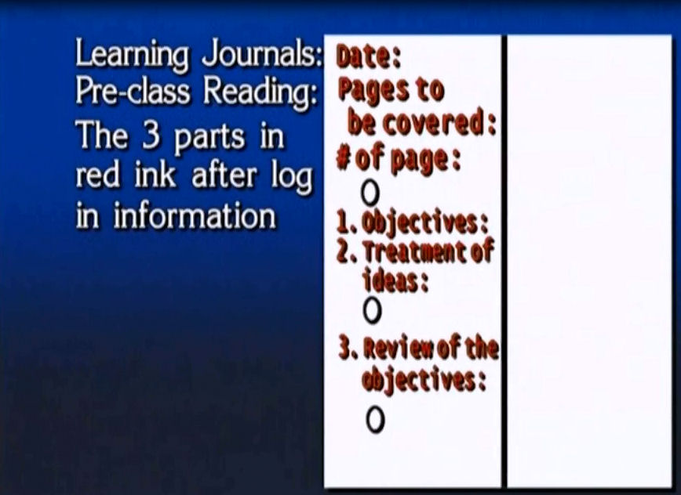
General Study Techniques and Values
Suggested note taking method from SS.
Take notes during pre-class reading:

Slide 17
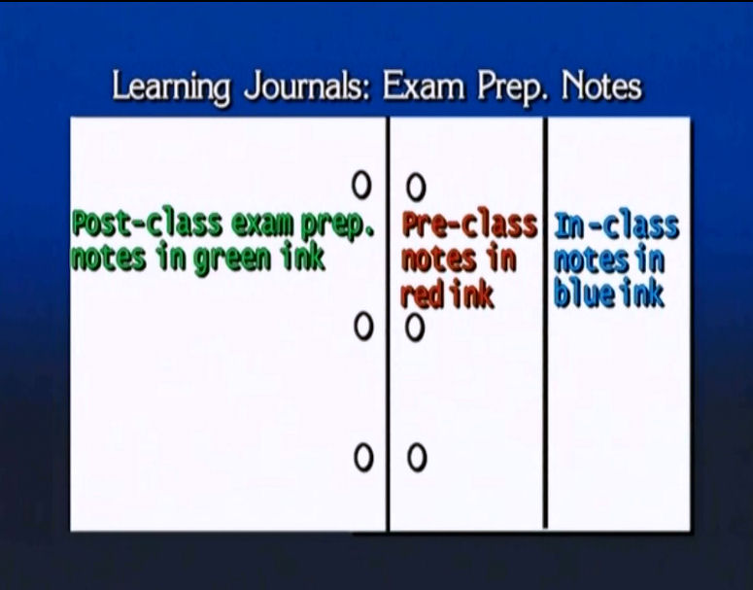
General Study Techniques and Values
Suggested note taking method from SS.
Take notes during class, but focus particularly on the issues left over from pre-class reading:

Slide 18
General Study Techniques and Values
Suggested note taking method from SS.
Post-class exam prep area is used to resolve any issues before the exam. (Post-class: after every class.)

Slide 19
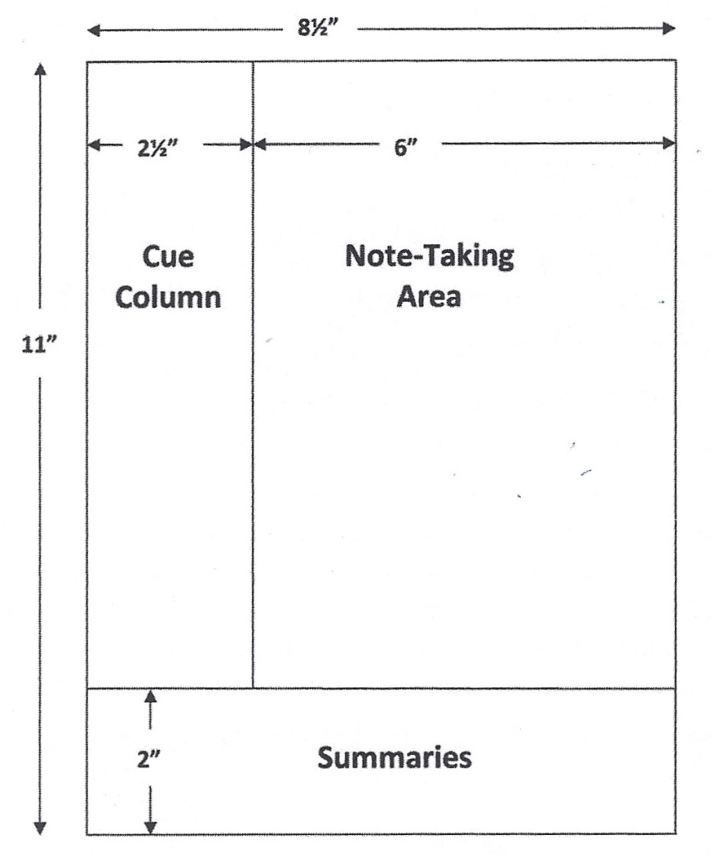
General Study Techniques
Suggested note taking method from SE (SE118).
The SE method is based on the Cornell Note Taking Method:
Cue Column: Questions and unresolved issues.
Summaries: Summary of content for each page. Exam prep summaries.
Word template can be downloaded from www.timeatlas.com, “5 Minute Tips.”

Slide 20
General Study Techniques and Values
Whatever system you use:
Read the book and practice before coming to class.
Take notes every day.
Resolve any issues that may be unclear on a day-to-day basis (that is, you should be studying from class to class, and not from test to test). This is what SE calls “take it as it comes.”
Work the section Check Points, the Study Suggestions, and the problems at the back of each chapter. Actively look for extra problems; don’t avoid them.
Practice writing questions of your own. What would you ask if you had to create an exam?
Take personal responsibility for mastering the material.

Slide 21
General Study Techniques and Values
Whatever system you use:
People who accomplish a great deal, without exception, do two things: (SE144)
They place a high value on their time.
No procrastination.
They have a system for scheduling and managing their time and tasks.
We won’t talk about time management here, but please engage on it.

Slide 22
General Study Techniques and Values
What characteristics do expert learners have? Three out of 18! (SE96)
They control the learning process rather than be victims of it.
They are active, not passive, in their approach to learning.
They tend to attribute failures to correctable causes. (What about the opposite? Blaming circumstances, etc.?)

Slide 23
General Values for Success
We’ve looked at several techniques that can lead to success, but there is a set of attitudes and values that are even more important.
How do you approach life?
What are your values, your dreams, your goals?
It is very important to think about these things, and to make a conscious effort to improve in all areas.
What happens inside a classroom is inextricably related to your approach to life itself.

Slide 24
General Values for Success
All growth requires stress of some kind.
Physical growth obviously requires stress, but so does mental and ethical/moral/spiritual growth.
Note that our decision making can become stronger too, just like our bodies and minds.
Consider an example:
For whatever reason, you didn’t get a programming assignment finished, and you have 15 minutes to turn it in. You know it won’t be ready.
You have a friend sitting next to you who is willing to give you his program, or you can turn it in as is and get a “C”.
What do you do?

Slide 25
General Values for Success
Consider an example:
For whatever reason, you didn’t get a programming assignment finished, and you have 15 minutes to turn it in. You know it won’t be ready.
If you take your friend’s program, you are lying to your instructor, to the school, and to everyone in the class who turned it in honestly.
But the real damage is being done to yourself.
What incentives have been created in your mind as a result of that decision? What happens when the next program comes around?
Such a decision weakens you and your decision making.

Slide 26
General Values for Success
Consider an example:
For whatever reason, you didn’t get a programming assignment finished, and you have 15 minutes to turn it in. You know it won’t be ready.
The opposite decision, turning in the program truthfully and accepting the consequences, strengthens you and your decision making.
Now you have to change your study techniques to do well. You’ve eliminated the option of dodging your responsibility.
The strong decision, made during a time of decision stress, makes you better able to withstand future stress. It makes you a stronger, better, more honest, person.
This is an example of taking responsibility for your actions (for your failure to complete the assignment in this case).

Slide 27
General Values for Success
A truly successful adult takes complete ownership of what he/she is doing.
Never make excuses.
Never be dishonest.
They always take responsibility for what they are doing.
(SE 24) “You must realize that whenever you take the easiest instructor, avoid a tough course, or cut a class, you’re hurting yourself. Whenever you make a conscious choice to avoid learning, growing, or developing, you’re not getting away with something: You are working against yourself.”

Slide 28
General Values for Success
A truly successful adult is serious about what he/she is doing.
They make goals, they plan, they self-reflect and they make changes when things aren’t going well. Their goals are always before them.
They realize that education is an investment in themselves (SE24), and they don’t take that lightly.
Immature students view the various tasks that their teachers and schools ask them to do as burdens, things to be avoided. They get into a mindset of avoidance, of trying to trick their way through the program in one way or another. These are students who haven’t fully taken responsibility for being here. Taking responsibility means, in part, that you are aware that you are making an investment in yourself with your education. The tasks that you will be given are then viewed as opportunities, not burdens. Personal responsibility means that you will take that seriously.

Slide 29
General Values for Success
Note that many people are supporting your presence here:
Parents, teachers, administrators, countless people behind the scenes stand ready to do whatever it takes to help you be successful.
Therefore, it is not honorable, to them or to yourself, to fail to take this seriously.
Failing to do your best is a failure of personal responsibility.
“Don’t let your poems be ordinary.” (Dead Poet’s Society) Well, don’t let your performance be ordinary.

Slide 30
General Values for Success
Have a good time, but work hard.
Be well.

